Slide 1
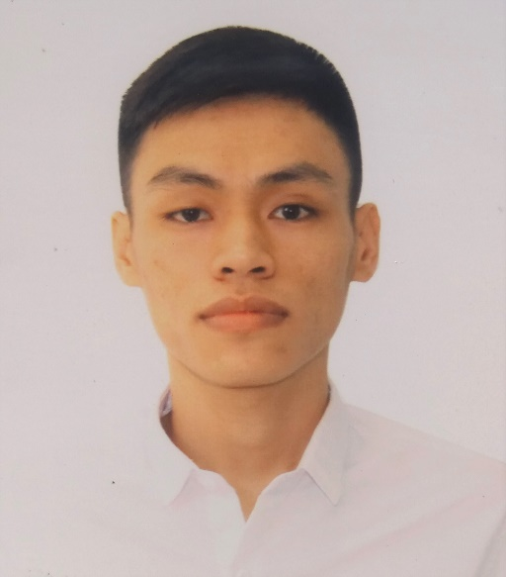




NGUYỄN ANH TÚ
MOBILE DEVELOPER
OBJECTIVE
SKILLS
Take advantages of mobile developer skills & experience has been accumulated more 2 years, I will contribute to development of Company.
- Computer Programming
Flutter, Android, IOS
Dart,Java, Kotlin, Swift
Nodejs, JavaScript
EDUCATION
- Soft skills
Industrial university of Ho Chi Minh city
Flutter, Android, IOS
Dart,Java, Kotlin, Swift
Nodejs, JavaScript
Major: Software engineering
EXPERIENCE
HOBBIES
Jun 2020 - Present K-Group
Team work, work independently
Creativity, Oral communication skills
Mobile Developer (Flutter, IOS, Android)
Project: Thế giới bác sĩ, Catback, Fiona Smart, Kiva Wallet.
Development with cross platform Flutter
Release app to Google play and Apple Store
CONTACT
Date of birth: 16/02/1998
Gender: Male
Phone: +84 345 016 610
Email: anhtu.it.se@gmail.com
Github: AnhTu6610
Address: Binh Thanh, Ho Chi Minh
Feb 2012 - May 2020 FPT Software
Interns Mobile Developer
PROJECT
Name of project | Thế giới bác sĩ
Description | Application to connect patients with doctors and pharmacies for online medical examination and treatment.
My position | Developer
My responsibilities | Development, review code, optimize code, bug fixing
Technologies used | Rest API, Push Notification, Google Map, Firebase, Location, HealthKit, Twilio (chat, video call), Facebook SDK,Google SDK

Slide 2
Name of project | Catback
Description | Cashback shopping app, link-up with third-party vendors.
My position | Developer
My responsibilities | Development, review code, optimize code, bug fixing
Technologies used | Rest API, Push Notification, Firebase, Dynamic Link, Facebook SDK,Google SDK
Name of project | Fiona Smart
Description | IOT application to control smart devices in the home
My position | Developer
My responsibilities | Development, review code, optimize code, bug fixing
Technologies used | Rest API, Push Notification, MQTT
FREELANCE PROJECTS
Name of project | Xe Toàn Thắng
Description | Application to book tickets online
My position | Developer
My responsibilities | Development, review code, optimize code, bug fixing
Technologies used | Rest API, Push Notification, VietMap SKD (Mapbox)
Name of project | eGas
Description | Application to sell Gas and kitchen appliances
My position | Developer
My responsibilities | Development, review code, optimize code, bug fixing
Technologies used | Rest API, Push Notification, Momo SKD, VNPay SDK
Name of project | BSF Smart Farm
Description | Application to sell agricultural products, tools used in agricultural products
My position | Developer
My responsibilities | Development, review code, optimize code, bug fixing
Technologies used | Rest API, Push Notification, Momo SKD, VNPay SDK

